Slide 1
CSC 660: Advanced OS
Memory Management

Slide 2
Topics
Physical Memory
Allocating Memory
Slab Allocator
User/Kernel Memory Transfer
Block I/O
I/O Schedulers

Slide 3
Physical Pages
MMU manages memory in pages
  4K on 32-bit
  8K on 64-bit
Every physical page has a struct page
  flags: dirty, locked, etc.
  count: usage count, access via page_count()
  virtual: address in virtual memory
Notes:
<linux/mm.h>

Slide 4
Zones
Zones represent hardware constraints
  What part of memory can be accessed by DMA?
  Is physical addr space > virtual addr space?
Linux zones on i386 architecture:
Zone | Description | Physical Addr
ZONE_DMA | DMA-able pages | 0-16M
ZONE_NORMAL | Normally addressable. | 16-896M
ZONE_HIGHMEM | Dynamically mapped pages | >896M

Slide 5
Allocating Memory
Page-level allocation
kmalloc(): byte-level allocation

Slide 6
Allocating Pages
struct page *alloc_pages(mask, order)
  Allocates 2^{order} contiguous physical pages.
  Returns pointer to 1st page, NULL on error.
  Logical addr: page_address(struct page *page)
Variants
  __get_free_pages: returns logical addr instead
  alloc_page: allocate a single page
  __get_free_page: get logical addr of single page
  get_zeroed_page: like above, but clears page.
Notes:
<linux/gfp.h>

Slide 7
External Fragmentation
The Problem
  Free page frames scattered throughout mem.
  How can we allocate large contiguous blocks?
Solutions
  Virtually map the blocks to be contiguous.
  Track contiguous blocks, avoiding breaking up large contiguous blocks if possible.

Slide 8
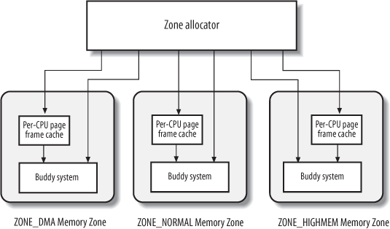
Zone Allocator

Slide 9
Buddy System
Maintains 11 lists of free page frames
  Consist of groups of 2^{n} pages, n=0..10
Allocation Algorithm for block of size k
  Allocate block from list number k.
  If none available, break a (k+1) block into two k blocks, allocating one, putting one in list k.
Deallocation Algorithm for size k block
  Find buddy block of size k.
  If contiguous buddy, merge + put on (k+1) list.

Slide 10
Per-CPU Page Frame Cache
Kernel often allocates single pages.
Two per-CPU caches
  Hot cache
  Cold cache

Slide 11
kmalloc()
void *kmalloc(size_t size, int flags)
  Sizes in bytes, not pages.
  Returns ptr to at least size bytes of memory.
  On error, returns NULL.
Example:
  struct felis *ptr;
  ptr = kmalloc(sizeof(struct felis), GFP_KERNEL);
  if (ptr == NULL)
  /* Handle error */
Notes:
<linux/slab.h>

Slide 12
gfp_mask Flags
Action Modifiers
  __GFP_WAIT: Allocator can sleep
  __GFP_HIGH: Allocator can access emergency pools.
  __GFP_IO: Allocator can start disk I/O.
  __GFP_FS: Allocator can start filesystem I/O.
  __GFP_REPEAT: Repeat if fails.
  __GFP_NOFAIL: Repeat indefinitely until success.
  __GFP_NORETRY: Allocator will never retry.
Zone Modifiers
  __GFP_DMA
  __GFP_HIGHMEM
Notes:
<linux/gfp.h>

Slide 13
gfp_mask Type Flags
GFP_ATOMIC: Use when cannot sleep.
GFP_NOIO: Used in block code.
GFP_NOFS: Used in filesystem code.
GFP_KERNEL: Normal alloc, may block.
GFP_USER: Normal alloc, may block.
GFP_HIGHUSER: Highmem, may block.
GFP_DMA: DMA zone allocation.
Notes:
<linux/gfp.h>

Slide 14
kfree()
void kfree(const void *ptr)
  Releases mem allocated with kmalloc().
  Must call once for every kmalloc().
Example:
  char *buf;
  buf = kmalloc(BUF_SZ, GFP_KERNEL);
  if (buf == NULL)
  /* deal with error */
  /* Do something with buf */
  kfree(buf);
Notes:
<linux/slab.h>

Slide 15
vmalloc()
void *vmalloc(unsigned long size)
  Allocates virtually contiguous memory.
  May or may not be physically contiguous.
  Only hardware devs require physical contiguous.
kmalloc() vs. vmalloc()
  kmalloc() results in higher performance.
  vmalloc() can provide larger allocations.

Slide 16
Slab Allocator
Caches frequently used kernel objects.
Advantages
  Performance: reduces page alloc/deallocs.
  Reduces memory fragmentation.
  Per-processor org reduce SMP lock contention.

Slide 17
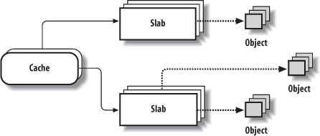
Slab Allocator Organization
Objects are grouped into caches.
Caches are divided into slabs.
Slabs are 1+ contig pages of alloc/unalloc objs.

Slide 18
Slab States
Full
  Has no free objects.
Partial
  Some free. Allocation starts with partial slabs.
Empty
  Contains no allocated objects.

Slide 19
Which allocation method to use?
Many allocs and deallocs.
  Slab allocator.
Need memory in page sizes.
  alloc_pages()
Need high memory.
  alloc_pages().
Default
  kmalloc()
Don’t need contiguous pages.
  vmalloc()

Slide 20
User/Kernel Memory Transfer
User (process) memory works differently than kernel memory.
  User pointers may not be valid in kernel code.
  User memory can be paged to disk.
Need special functions to transfer data btw kernel/user space:
unsigned long copy_to_user(
void __user *to,
const void *from,
unsigned long count);
unsigned long copy_from_user(
void *to,
const void __user *from,
unsigned long count);

Slide 21
Block vs Character I/O
Block I/O
  One block at a time.
  Random access.
  Seekable.
  Kernel block layer.
Character I/O
  One byte at a time.
  Sequential.
  Not seekable.
  No subsystem needed.

Slide 22
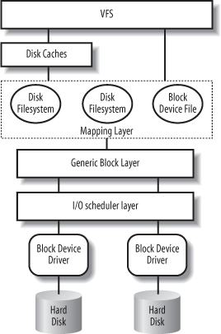
Block I/O Layer in Context
Notes:
Fig 14.1 from ULK, 3/e

Slide 23
Blocks and Buffers
Blocks stored in memory in buffers.
Buffers described by struct buffer_head
  b_state: flags (uptodate, dirty, lock, etc.)
  b_count: usage count
    get_bh();
    /* do stuff with buffer */
    put_bh();
  b_page: physical page location
  b_data: pointer to data within physical page

Slide 24
The bio Structure
Describes I/O ops involving one or more blocks.
struct bio
bi_io_vec
bi_idx
bio_vec
bio_vec
bio_vec
bio_vec
page
page
page
page
Notes:
Fig 13.2, LKD 2/e
<linux/bio.h>

Slide 25
bio_vec
struct bio_vec {
/* physical page of buffer */
struct page *bv_page;
/* length in bytes of buffer */
unsigned int bv_len;
/* location of buffer w/i page */
unsigned int bv_offset;
};

Slide 26
Request Queues
Block devices store pending I/O in queues.
  Each queue is a request_queue structure.
Requeue queues
  Doubly linked list of struct request
  Each struct request can contain multiple bio structures representing contiguous I/Os.
Managed by I/O schedulers.

Slide 27
I/O Schedulers
Manage I/O requests to improve performance.
  Performance = global throughput.
  May or may not attempt to be fair.
Two tasks
  Merging: concatenate adjacent requests.
  Sorting: order requests to reduce seeking.

Slide 28
Kernel I/O Schedulers
Linus Elevator
Deadline
Anticipatory
Noop
CFQ

Slide 29
Linus Elevator
Default in 2.4 kernel, many OSes.
Elevator algorithm
  Merge adjacent requests.
  Sorts queue by location on disk.
  Queue seeks sequentially across disk in one direction then other, minimizing global seek time.
Age threshhold prevents starvation.
  New requests inserted at tail instead of in order.

Slide 30
Deadline
Read FIFO Queue
disk
Write FIFO Queue
Dispatch
Queue
Sorted Queue
Sorted queue: sorted by location on disk.
Read/Write FIFO queues: FIFO reads and writes.
Dispatch queue: pulls requests from sorted queue except when request at r/w FIFO head expires.

Slide 31
Anticipatory
Deadline + anticipation heuristic.
Waits after read request submitted.
  Does nothing for a few ms (6ms by default.)
  In that time, application likely to read again.
  Reads tend to occur in contiguous groups.

Slide 32
Noop
Merges I/Os, but does no sorting.
  Essentially maintains a FIFO queue.
Used for non-seeking block devices.
  Flash memory

Slide 33
CFQ
Complete Fair Queuing
  Maintains a sorted queue for each process.
  Round robin service to process queues.
  Fair at a per-process level.
Used for multimedia applications
  Players can refill buffers in acceptable time.

Slide 34
References
Daniel P. Bovet and Marco Cesati, Understanding the Linux Kernel, 3rd edition, O’Reilly, 2005.
Johnathan Corbet et. al., Linux Device Drivers, 3rd edition, O’Reilly, 2005.
Robert Love, Linux Kernel Development, 2nd edition, Prentice-Hall, 2005.
Claudia Rodriguez et al, The Linux Kernel Primer, Prentice-Hall, 2005.
Peter Salzman et. al., Linux Kernel Module Programming Guide, version 2.6.1, 2005.
Andrew S. Tanenbaum, Modern Operating Systems, 3rd edition, Prentice-Hall, 2005.

